Slide 1
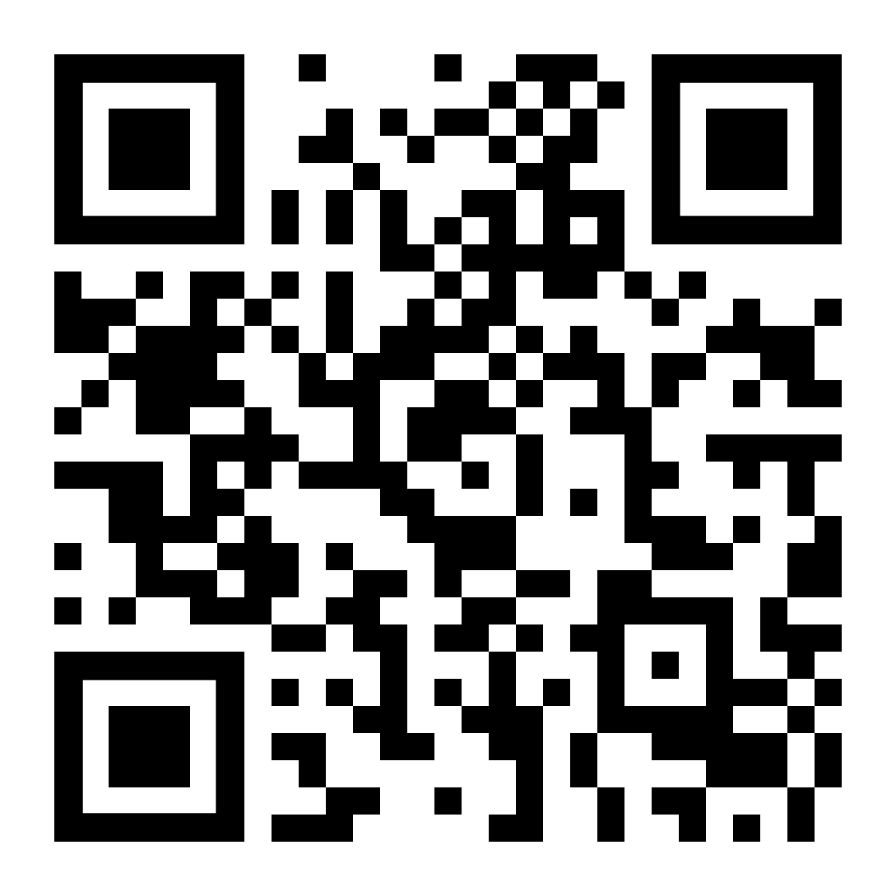
16x9 ration plasma template
Module evaluations
Scan the QR code below to complete your module evaluation surveys.
You can also access your surveys by logging in to Minerva or visiting https://leeds.bluera.com/leeds/
For help, email TheLeedsPartnership@leeds.ac.uk.

