Slide 1

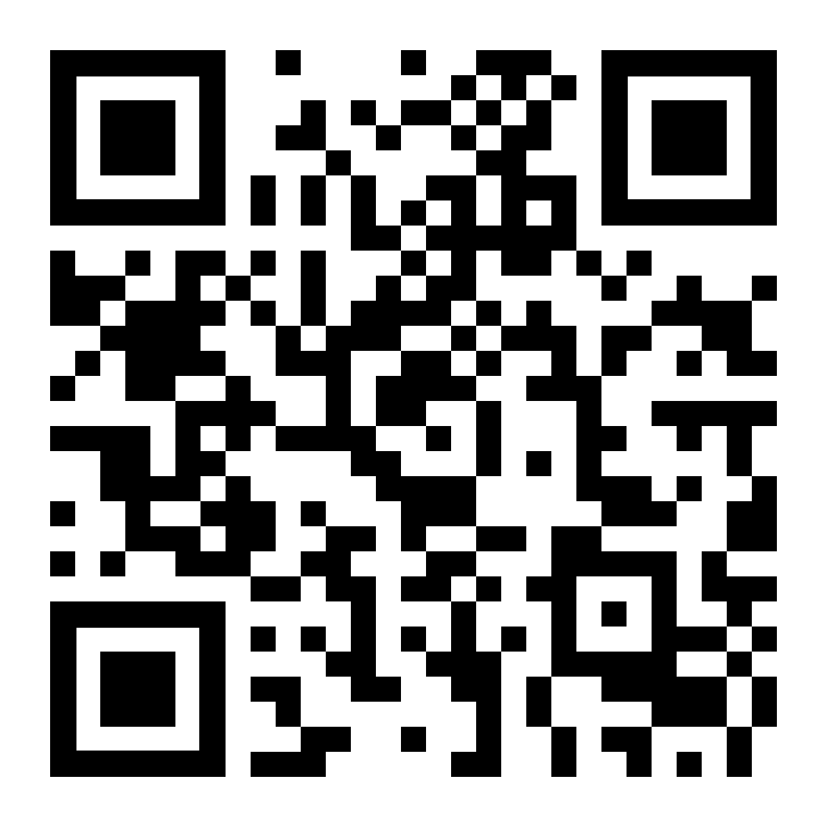
Completing your Module Evaluation using Explorance Blue
Access your module evaluations via:
Website: go to https://leeds.bluera.com/leeds/ to reach your personalized homepage.
Email: search for an email from TheLeedsPartnership@leeds.ac.uk and click on the link.
Minerva: log in – you will see an overlay inviting you to complete your module evaluations.
QR code: scan the QR code opposite to reach your personalized homepage.
When signing in:
Use your University of Leeds username (include @leeds.ac.uk at the end) and password.
Help and support:
If you need help, are having problems, or have a question please email TheLeedsPartnership@leeds.ac.uk

