Slide 1
LeedsforLife Leadership Forum
In this session...
Refreshing the Vision
Why now?
Academic personal tutoring
Supporting student-led conversations
Training and development
We need your support to fulfil the promise of LeedsforLife

Slide 2
Refreshing the vision

Slide 3
LeedsforLife Making the most of your time at Leeds!
We will empower you to prepare for your future, enabling you to be successful in a way that is meaningful to you.

Slide 4
LeedsforLife Making the most of your time at Leeds!
Our commitment. Together we will:
Ensure you are valued as an individual and as a member of our community.
Encourage you to reflect on what success means for you. How do you see your future?
Articulate your skills and attributes. You will be developing through all your experiences on your course and beyond.
Identify your development needs in terms of knowledge, skills and understanding, all with your future in mind.
Empower you to make informed choices, helping you to navigate:
Student opportunities
Curriculum options
Support services
Support your development as a lifelong learner; here for you beyond graduation.

Slide 5
LeedsforLife Making the most of your time at Leeds!
Informed choices.
We will help you navigate...
Student opportunities
volunteering, employment experience, study and work placements, careers information, advice and guidance, enterprise, preparing for further study
Curriculum options
using the flexibility within your course (optional modules, discovery themes, project or dissertation choices) to help you prepare for your future
Support services
accessing the range of professional services to help you succeed on your course and in the future

Slide 6
Why now?

Slide 7
LeedsforLife Why change now?
Student experience, success and futures
Importance of developing a sense of belonging
Student expectations are changing
Digital student experience 'art of the possible' - wide involvement staff and students, key message around easily accessible content
Academic personal tutoring relationship remains at the heart of LeedsforLife

Slide 8
LeedsforLife Why change now?
Functionality that meets our needs
Reviewed existing LeedsforLife systems
Currently use unsupported technologies, no longer fit for purpose
Identified a plan
decommission in-house systems
move to new & existing tools, with wider applications

Slide 9
Academic Personal Tutoring

Slide 10
Academic personal tutoring Central to student experience
University-wide review: Academic personal tutoring remains at the heart of our commitment to all taught students through LeedsforLife
Evidence-informed: Templates of good practice, informed by pedagogical research undertaken by LITE fellows, for schools to adapt and share
Valuing the Partnership: student-led conversations, developing a sense of belonging

Slide 11
Academic personal tutoring Central to student experience
Extensive consultation this year has led to:
A much greater understanding of the 'ask' we make of our colleagues in this important role
A new network for school leads for APT
Sharing of best practice with all APTs via Minerva

Slide 12
Academic personal tutoring Central to student experience
Next steps
Remains a key focus for student experience
Core to developing a sense of belonging
To follow on from the essential training, a suite of development for APTs will begin in the Autumn, led by OD&PL
Important work ongoing around reward and recognition and workload

Slide 13
A glimpse of work underway on presenting a shared vision for Academic Personal Tutoring
Academic
It's Academic. It's not your job to deal with pastoral issues other than to signpost to the right place. Likewise it's not your job to give detailed information about programmes, that's for the Programme Manager and SES.
It's Academic. It is your job to help your tutee see the coherence of their formal curricular and cocurricular progress, to help them act on academic feedback and to support academic aspects of personal development.
Personal
It's Personal. It's not your job to set the Agenda for meetings. It's for your Tutee to set their Agenda, with support where needed of course.
It's Personal. It is your job to facilitate your tutee in developing a "sense of belonging", to feel at home on their Programme and in their School.
It is your job! Or at least part of it. Please make sure you have the support you need to be a good AP Tutor.
It is the University's responsibility to ensure you have the time, training and support to be a good AP Tutor. You should also be rewarded and recognised for your efforts.
Tutoring

Slide 14
Supporting student-led conversations

Slide 15
PebblePad New tool for LeedsforLife
PebblePad will host a new LeedsforLife workbook
Core institutional content has been developed for each of the LeedsforLife themes, appropriate to the students' level of study
Content visible to student and tutor
Encourages reflective practice
Facilitates students’ sense of belonging at Leeds
Student–led conversations with academic personal tutor

Slide 16
PebblePad New tool for LeedsforLife
Timings for moving to the new tool
The refreshed LeedsforLife approach will be launched to students as part of Welcome, Induction, Transition from mid-August
PebblePad in use for academic personal tutoring for all UG and PGT students from the Autumn
PGTs who joined in January will be able to use the existing tool until end December

Slide 17
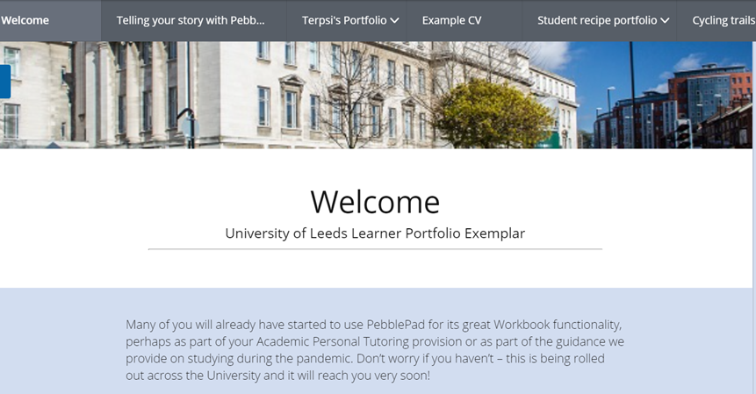
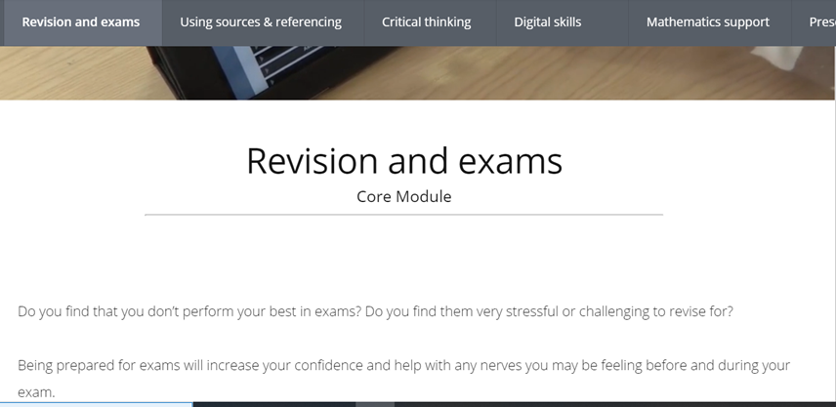
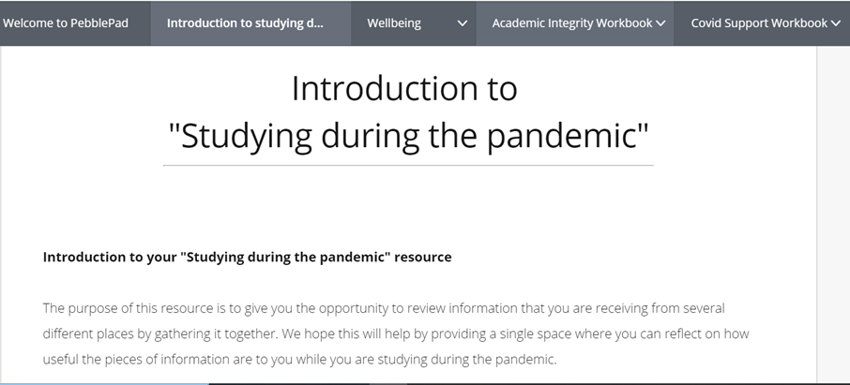
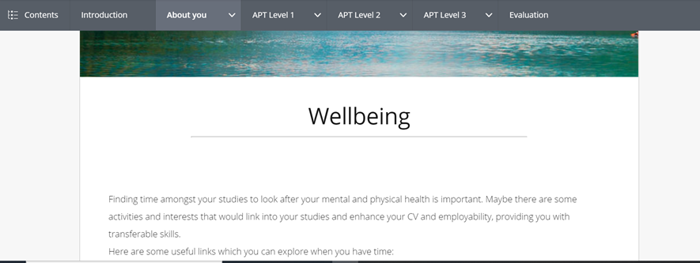
How will the PebblePad system look?
These are example views
The LeedsforLife workbook is being built in the system at the moment

Slide 18
Learning Analytics Informing conversations
Will provide individual student dashboards with up-to-date learning engagement information on use of digital education resources. Helps inform conversations between students and tutors about academic progress
Will provide students with increased autonomy over their learning journey and help them to shape and structure their own approaches to learning alongside their own personal goals & measures of success

Slide 19
Learning Analytics Informing conversations
Piloted across a number of Schools with students, academic & professional service colleagues
Staff & students providing feedback to help inform the system & its wider roll-out in September
Virtual classrooms (BB Collaborate, MS Teams, Zoom), Banner, Minerva, Library eResource and loan, and MS Stream data, will all be integrated for September launch

Slide 20
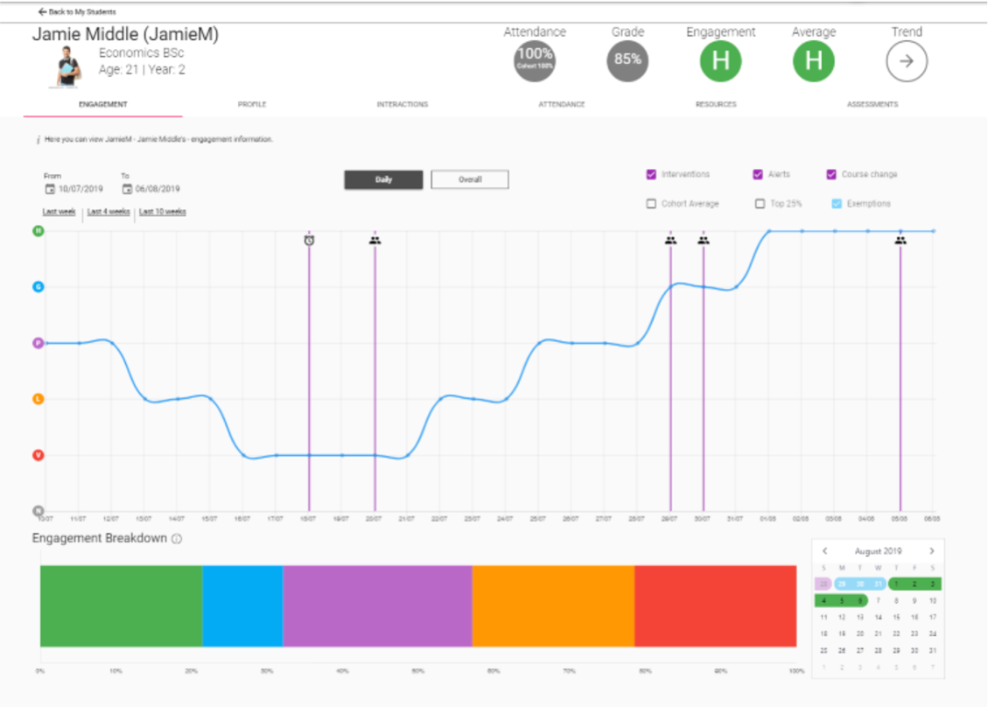
How will the learning analytics dashboards look?

Slide 21
Training and development

Slide 22
Training & Development Supporting colleagues
Combining development with practical training on systems
Faculty LeedsforLife briefings hosted by your Faculty Pro Dean for Student Education 24 June – 8 July, 50mins
Essential training for Academic Personal Tutors including use of systems, sharing good practice, developing a sense of belonging July onwards, 90mins

Slide 23
We need your support to fulfil the promise of LeedsforLife

Slide 24
LeedsforLife Needs you!
Your leadership
Please encourage colleagues to engage
And help them make time for this important role
We will keep you informed
Fortnightly LeedsforLife updates across MS Teams
Stay in touch
View all the latest news and resources on our project website or get in touch LeedsforLife@leeds.ac.uk

