Slide 1
Support at Leeds
A session with information and activities to help you to:
find out about your support network
take care of yourself and your student community
1
Notes:
1

Slide 2
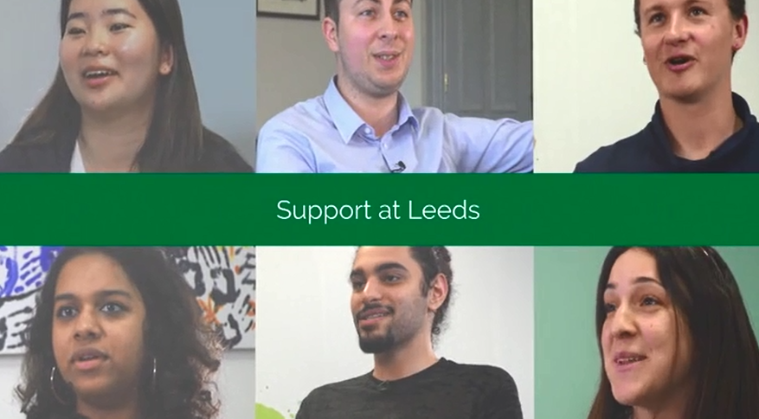
Introduction to our support for you
Notes:
2

Slide 3
Our Vision
“To enable and empower you to engage fully with
all aspects of student life, removing barriers as necessary, so you can achieve your potential and succeed in your studies’’
It’s about…..
Maintaining
your
wellbeing
‘ where each individual realises his or her own potential, can cope with the normal stresses of life, can work productively and fruitfully and is able to make a contribution to his or her community’
World Health Organisation
Meeting challenges
‘a task or situation that tests a person’s abilities’
Oxford dictionaries https://en.oxforddictionaries.com
Notes:
3

Slide 4
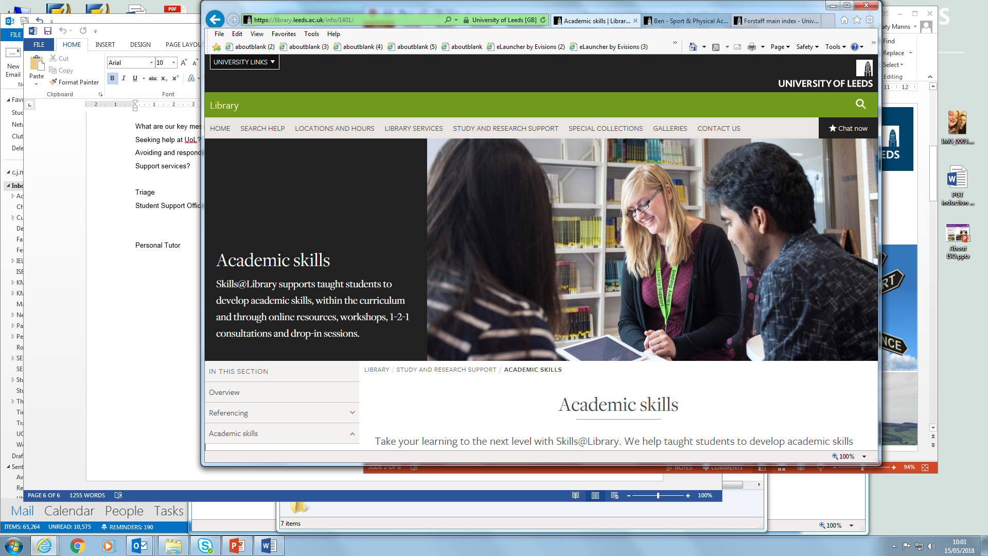
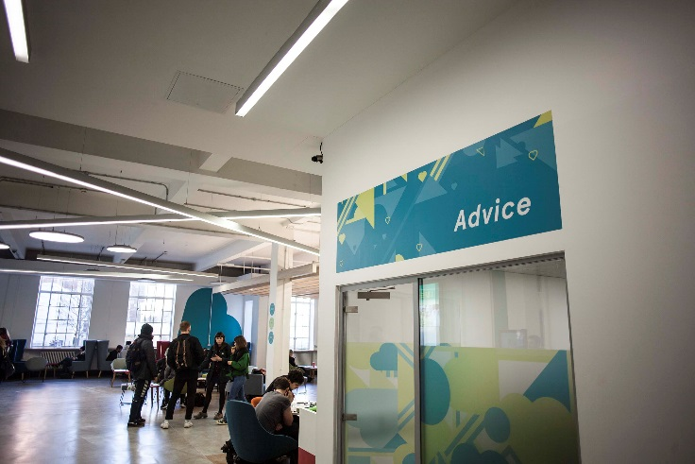
A wide range of support
Support to manage student life and develop skills to meet challenges
Activities to build friendships and maintain your wellbeing and health
Free specialist confidential support services and independent advice
Notes:
4

Slide 5
Online information you can use independently
  https://students.leeds.ac.uk
  Faculty/School website/Minerva area
  luu.org.uk
Contact points for questions and to find out how to get the right support
  Student Office in School
  Help and Support in Leeds University Union
  Personal Tutor (academic support)
  Skills@Library (study skills)
  Advice in Leeds University Union
  Student Counselling and Wellbeing
  Disability Services
  Student Services (including finance)
  International Student Office (immigration)
  Lifelong Learning Centre (mature students)
  Accommodation Wardens and Residence Life Assistants
  Chaplaincy and Muslim Student Adviser
  University Security
Specialist support and advice to enable and empower you to meet challenges
Notes:
5

Slide 6
Student Counselling and Wellbeing
Free, confidential, specialist support from an experienced team of counsellors, mental health advisers and wellbeing practitioners
The team works with students to identify solutions to difficulties and signpost or refer to specialist services in Leeds
Support includes: wellbeing drop-ins; single session consultations; groups and workshops; online resources; short series of counselling or wellbeing appointments; weekly meditation; downloadable relaxation MP3s on website
To book an appointment, complete the Student Counselling and Wellbeing Self-Referral Form on https://students.leeds.ac.uk/counsellingandwellbeing
Notes:
6

Slide 7
Disability Services
Confidential, specialist advice, guidance and support for disabled students, including those with physical disabilities, mental health conditions, autism spectrum condition, specific learning needs (e.g. dyslexia) and long term medical conditions.
The team identifies and recommends adjustments schools can make for individuals.
Start by filling in Disability Services’ online sign-up form at
https://students.leeds.ac.uk/settingupyoursupport
Perhaps you had support or adjustments at school or during previous study? Contact the team at disability@leeds.ac.uk, or look at the website below to see if you might benefit from the team’s services.
Contact our friendly Disability Services team to find out more. No appointment needed, confidential drop-ins between 9:30am and 4pm Monday to Friday.
http://students.leeds.ac.uk/disabledstudents
Notes:
7

Slide 8

Funding and Money Support
Student Funding Team in Student Services Centre
Help and guidance on student funding
Can communicate directly with Student Finance England (and other funding bodies) to help resolve funding issues
Administer applications to Leeds Hardship Fund
and International Leeds Hardship Fund https://students.leeds.ac.uk/fundsandscholarships
You can email to the Student Finance team at funding@leeds.ac.uk
Advice in Leeds University Union
Money help, budgeting advice, financial support
luu.org.uk/student-help-support
Notes:
8

Slide 9


Activities for friendship, wellbeing and health
Five Ways to Wellbeing*
Connect
Be active
Take notice (mindfulness)
Keep learning
Give
*Five ways to wellbeing report New Economics Foundation
Notes:
9

Slide 10
Our Support Partnership
Students:
University & Leeds University Union (LUU):
seek information/ advice/support in good time
contribute positively to your community
let University/
Leeds University Union (LUU)
know about problems
or what may
need to change
empower you to manage student life and meet challenges
work with students to understand what’s
happening and what’s needed
develop and provide support services and activities
LUU
STUDENTS
OUR
SUPPORT PARTNERSHIP
UNIVERSITY
Notes:
10

Slide 11





Students supporting students, for example:
School-based peer support
School reps (representatives)
Academic societies
Other student-run societies
luu.org.uk/clubs-and-societies/welfare/
Notes:
11

Slide 12

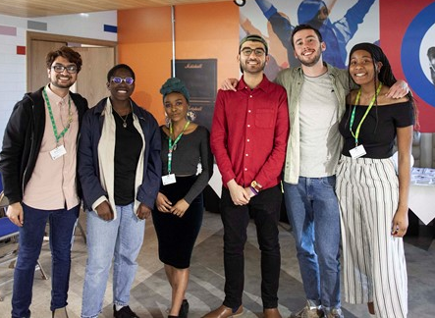
Another example …
A partnership of students, University and Leeds University Union staff developed the “Draw the Line” project to help the University community to stand up to harassment.
The project raises awareness of the campus online reporting form and the support available from LUU Advice
PROJECT AMBASSADORS
LUU ADVICE
Notes:
TIMING: 3mins
PURPOSE OF SLIDE: to give another example of how the partnership works using the skills and experience of staff and students, and how students are empowered to take action to solve problems and support their community. It also provides a chance to positively highlight the Draw the Line campaign, on line reporting form and safety support from campus police and LUU Advice
KEY MESSAGES: the student voice is important and will result in positive change – harassment is not acceptable – report it
12

Slide 13
Emergency and outside office hours contact points
University Security Office
Open 24 hours, every day of the year
175 Woodhouse Lane
email security@leeds.ac.uk
Tel: 0113 343 5494 or 0113 343 5495 (non-emergencies)
Tel: 0113 343 2222 (emergencies)
Wardens & Residence Life Assistants in University accommodation
Ambulance/Police/Fire Emergency
phone 999
Police non-emergency phone 101
Nearest Hospital Accident & Emergency is at Leeds General Infirmary
If an ambulance is called for on campus, telephone University Security to inform them
Wellbeing Crisis information on https://students.leeds.ac.uk/supportandwellbeing
Notes:
13

Slide 14
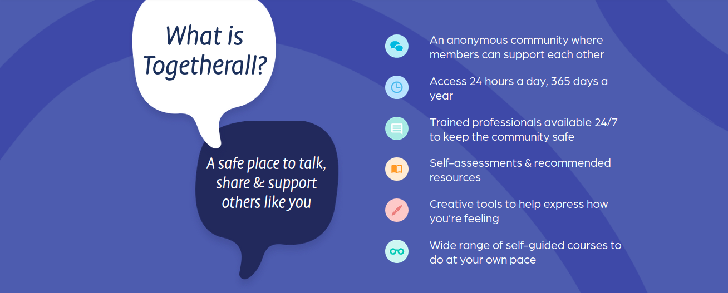
Together all – Wellbeing support at any time
Free to all students at the University of Leeds - togetherall.com
Notes:
14

Slide 15
Supportive conversation with another student
Leeds Nightline
1 to 1 with a trained student outside office hours
Talk to school Student Support Officer
Universities Chaplaincy
1 to 1 with a Chaplain
Personal tutor for academic support
Support when you need it
Sport and Physical Activity
Activity to support your wellbeing
Skills@Library
study skills workshops,
appointments and resources
Student Counselling and Wellbeing
workshops, groups and online resources
Disability Services
support for students affected by a long term condition e.g. dyslexia
Together all
online resources and support
Leeds University Union
wellbeing and social activities and workshops
Notes:
15

Slide 16
Take away messages …
Your time at University will test you in different ways, but you’ll be
empowered to find solutions. You’ll develop skills to meet challenges
while you’re studying and in your future lives.
Make time for wellbeing (5 ways) – for the best experience and academic results
Remember the range of support offered by the University, Leeds University Union and other students, including 24/7
Ask for help as soon as you need it. It’s a normal part of University life, a strength not a weakness.
A warm welcome to our supportive University community!
Notes:
16

