Slide 1
Support at Leeds
An interactive session with information and activities to help you to:
find out about your support network
take care of yourself and your student community
Name
Job Title

Slide 2
Welcome! Congratulations! How are you feeling?
Activity: Which egg are you?
Which expression (eggspression!) matches how you’re feeling?
Introduce yourself to the person next to you and talk about which colour egg you chose and why.
Listen carefully – this session will help you, whichever egg you are feeling like!

Slide 3
Introduction to our support for you

Slide 4
Our Vision “To enable and empower you to engage fully with all aspects of student life, removing barriers as necessary, so you can achieve your potential and succeed in your studies’’
It’s about…..
Maintaining
your wellbeing
‘ where each individual realises his or her own potential, can cope with the normal stresses of life, can work productively and fruitfully and is able to make a contribution to his or her community’
World Health Organisation
Meeting challenges
‘a task or situation that tests a person’s abilities’
Oxford dictionaries https://en.oxforddictionaries.com

Slide 5
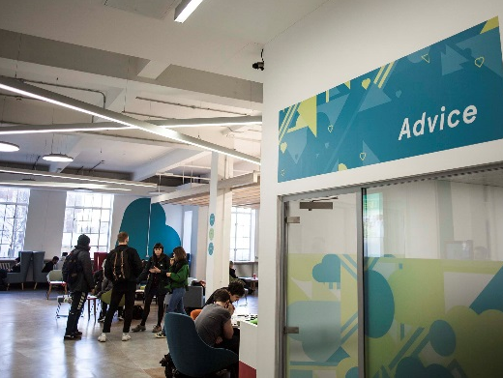
A wide range of support
Support to manage student life and develop skills to meet challenges
Activities to build friendships and maintain your wellbeing and health
Free specialist confidential support services and independent advice

Slide 6
Online information you can use independently
https://students.leeds.ac.uk
Faculty/School website/Minerva area
luu.org.uk
Contact points for questions and to find out how to get the right support
Student Office in School
Help and Support in Leeds University Union
Personal Tutor (academic support)
Skills@Library (study skills)
Advice in Leeds University Union
Student Counselling and Wellbeing
Disability Services
Student Services Centre (including finance)
International Student Office (immigration)
Lifelong Learning Centre (mature students)
Accommodation Wardens and Sub-wardens
Chaplaincy and Muslim Student Adviser
University Security & Campus Police Officer
Specialist support and advice to enable and empower you to meet challenges

Slide 7
Student Counselling and Wellbeing
Free, confidential, specialist support from an experienced team of counsellors, mental health advisers and wellbeing practitioners
The team works with students to identify solutions to difficulties and signpost or refer to specialist services in Leeds
Support includes: wellbeing drop-ins; single session consultations; groups and workshops; online resources; short series of counselling or wellbeing appointments; weekly meditation; downloadable relaxation MP3s on website
To book an appointment on campus, complete the Student Counselling and Wellbeing Self-Referral Form on https://students.leeds.ac.uk/counsellingandwellbeing

Slide 8
Disability Services
Confidential, specialist advice, guidance and support for disabled students, including those with physical disabilities, mental health conditions, autism spectrum condition, specific learning needs (e.g. dyslexia) and long term medical conditions.
The team identifies and recommends adjustments schools can make for individuals.
Start by filling in Disability Services’ online sign-up form at https://students.leeds.ac.uk/settingupyoursupport
Perhaps you had support or adjustments at school or during previous study? Contact the team at disability@leeds.ac.uk, or look at the website below to see if you might benefit from the team’s services.
Visit our friendly Disability Services team to find out more. No appointment needed, confidential drop-ins between 9:30am and 4pm Monday to Friday. http://students.leeds.ac.uk/disabledstudents

Slide 9
Funding and Money Support
Student Funding Team in Student Services Centre
Help and guidance on student funding
Can communicate directly with Student Finance England (and other funding bodies) to help resolve funding issues
Administer applications to Leeds Hardship Fund and International Leeds Hardship Fund https://students.leeds.ac.uk/fundsandscholarships
You can talk to the Student Finance team in Student Services Centre or email funding@leeds.ac.uk
Advice in Leeds University Union
Money help, budgeting advice, financial support luu.org.uk/student-help-support

Slide 10
Activities for friendship, wellbeing and health
Five Ways to Wellbeing*
Connect
Be active
Take notice (mindfulness)
Keep learning
Give
*Five ways to wellbeing report New Economics Foundation
Activity: Your way(s) to wellbeing
Introduce yourself and share with a partner:
what you usually do for your wellbeing
what you could do/would like to do this year

Slide 11
Our Support Partnership
Students:
University & Leeds University Union (LUU):
seek information/ advice/support in good time
contribute positively to your community
let University/ Leeds University Union (LUU) know about problems or what may need to change
empower you to manage student life and meet challenges
work with students to understand what’s happening and what’s needed
develop and provide support services and activities
LUU
STUDENTS
OUR SUPPORT PARTNERSHIP
UNIVERSITY

Slide 12
Students supporting students, for example:
School-based peer support
School reps (representatives)
Academic societies
Other student-run societies
luu.org.uk/clubs-and-societies/welfare/

Slide 13
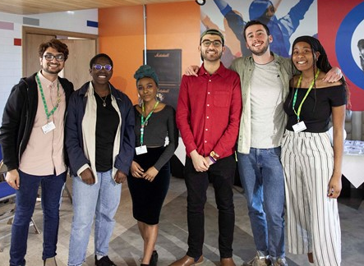
Another example …
A partnership of students, University and Leeds University Union staff developed the “Draw the Line” project to help the University community to stand up to harassment.
The project raises
awareness of the campus online reporting form and the support available from LUU Advice and our campus police officer PC Becky Hurrell R.Hurrell@leeds.ac.uk
PC BECKY HURRELL
PROJECT AMBASSADORS
Notes:
TIMING: 3mins
PURPOSE OF SLIDE: to give another example of how the partnership works using the skills and experience of staff and students, and how students are empowered to take action to solve problems and support their community. It also provides a chance to positively highlight the Draw the Line campaign, on line reporting form and safety support from campus police and LUU Advice
KEY MESSAGES: the student voice is important and will result in positive change – harassment is not acceptable – report it

Slide 14
Emergency and outside office hours contact points
University Security Office
Open on campus 24 hours, every day of the year
175 Woodhouse Lane
email security@leeds.ac.uk
Tel: 0113 343 5494 or 0113 343 5495 (non-emergencies)
Tel: 0113 343 2222 (emergencies)
Wardens & Sub-wardens in University accommodation
Ambulance/Police/Fire Emergency phone 999
If ambulance is needed on campus, ring University Security first
Police non-emergency phone 101
Nearest Hospital Accident & Emergency is at Leeds General Infirmary
Wellbeing Crisis information on https://students.leeds.ac.uk

Slide 15
Big White Wall – Wellbeing support at any time
bigwhitewall.com

Slide 16
Explore ideas and strategies to help you:
Navigate change and cultural differences
Make friends and maintain your wellbeing
Find support and discover opportunities
Thrive in your academic and social life at Leeds
Learn from:
Videos and interactive activities
Students’ and researchers’ experiences
Explore the guides at your own pace

Slide 17
Supporting each other
Leeds Nightline
1 to 1 with a trained student outside office hours
Talk to school Student Support Officer
Supportive conversation with another student
Universities Chaplaincy
1 to 1 with a Chaplain
Personal tutor for academic support
Your friend Alex isn’t sure about being able to meet all the academic deadlines this term
Get Out Get Active
sociable trips and physical activities
Skills@Library
study skills workshops, appointments and resources
Student Counselling and Wellbeing
workshops, groups and online resources
Disability Services
support for students affected by a long term condition e.g. dyslexia
Big White Wall and Feeling at Home in Leeds
online resources and support
Leeds University Union
wellbeing and social activities and workshops

Slide 18
Take away messages …
Your time at University will test you in different ways, but you’ll be empowered to find solutions. You’ll develop skills to meet challenges while you’re studying and in your future lives.
Make time for wellbeing (5 ways) – for the best experience and academic results
Remember the range of support offered by the University, Leeds University Union and other students, including 24/7
Ask for help as soon as you need it. It’s a normal part of University life, a strength not a weakness.
A warm welcome to our supportive University community!

