Slide 1
Teaching Enhancement Scheme (TES)
TES can reflect and develop the enhancement activities that should already be taking place

Slide 2
Teaching Enhancement Scheme
Designed to
be a simple, flexible and developmental process
enhance teaching including; curriculum design, assessment, blended learning etc….
should fit with any existing School enhancement activities eg;
learning and teaching away-days
lunchtime discussion/seminar series
working groups on assessment practices, criteria etc………….
TES
should develop rather than add to these activities
is an opportunity to encourage and engage more (all) staff in enhancement activities

Slide 3
University of Leeds Teaching Enhancement Scheme (TES) May 2013
Light touch co-ordination and reporting
PLAN
What do we want to focus on and why?
How do we want teaching/learning to benefit?
How are we going to achieve this?
How will we know success?
Will we need any support?
What are the timescales for the TES process?
Normally 1-2 year cycle
FUTURE ACTIONS
Success: Implement and disseminate
Some benefits: continue another cycle?
No benefit: Re-focus Plan stage or move
on and disseminate
DO
Implement agreed plan
REFLECT
Analyse: outcomes achieved?

Slide 4
Planning & Organising TES
TES projects / activities:
Can be identified by individuals, pairs, cross-school groupings, programme teams …
Provide an opportunity for junior colleagues to lead on local developments e.g. as part of ULTRA
In response to:
individual interests e.g. use of social media in teaching
individual's own perceived development needs e.g. via SRDS
module/programme team initiatives
action plans and priorities e.g. to respond to NSS
School strategies e.g. curriculum review, blended learning
TES can reflect and develop the enhancement activities that should already be taking place

Slide 5
Planning & Organising TES
TES activities do need to be co-ordinated and agreed
ultimate responsibility for the quality of learning and teaching lies with the Head of School (HoS)
HoS normally delegates co-ordination of TES to a nominated individual
Light touch process of recording involvement for monitoring purposes
Separate from management and performance processes
Staff keep their discussions confidential
Staff are encouraged to share and disseminate positive (and negative) ideas, outcomes and recommendations through a report
TES cycle may normally last one or two years

Slide 6
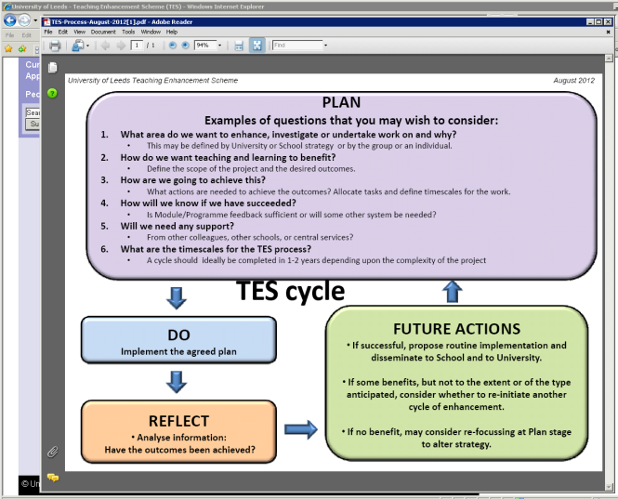
Staff information and forms
Website with links to the TES documentation:
http://www.leeds.ac.uk/qat/tes/
TES Draft Policy
FAQ’s
CASE studies
TES forms: (1) Record of Starting a TES cycle
(2) For Participants to record their activities
(3) Non-confidential Report form

Slide 7
TES Pilot Studies
Pilot studies were undertaken during 2012-13 and used distinct approaches;
School of Mathematics
Defined topics and some direction
Prof John Wood
School of Healthcare
Free staff choice
Dr Janet Holt

Slide 8
Teaching Enhancement Scheme Pilot in Mathematics
School TSEC agreed on a list of TES themes.
Teaching staff asked to identify their top three choices.
Participants organised into groups, some members of staff directed to a particular group based on need or expertise. One member of each group named as (initial) convener.
Lecturers receiving poor feedback were directed into the Teaching Observation Group; other lecturers encouraged to join this group.
The discussions of all groups confidential to the group.
All groups fill out TES form at the start and produce report on their activities at end to feedback outcomes including any recommendations to School TSEC.
7. At the end of the year, if the work of the group is not completed, normally that group will be able to continue for a second year.

Slide 9
Themes for 2012-13
1. Alternative Methods of Examining. e.g. oral.
2. Providing effective feedback.
3. Improving hand-in rates of coursework at level 3 and 5M.
4. Improving student confidence and communication skills.
5. Revision to Final Year Projects.
6. Project marking and feedback.
7. e-Learning tools for Maths.
8. Academic integrity of students in assessed coursework.
9. Teaching Observation.

Slide 10
Outcomes so far
Some ideas presented from three groups:
Providing effective feedback. Present an incorrect solution in
workshops/tutorials for discussion.
Improving student confidence and communication skills. Give written work marks for presentation.
e-Learning tools for Maths. E-assessment trial mostly successful; consider e-discussion boards, podcasts of lectures.
See http://www1.maths.leeds.ac.uk/school/staff/teaching/Teaching Enhancement Scheme.html

Slide 11
Pilot in the School of Healthcare
Large multi-professional school
Adult, Child and Mental Health Nursing
Midwifery
Audiology
Cardiology
Diagnostic Radiography
Counselling and Psychotherapy
Pharmacy
Social Work
8 UG programmes and 4PG programmes leading to registration as a health professional or social worker
UG & Masters programmes for health professional CPD
2011/12 - 42 programmes in total

Slide 12
Approach
Discussion at TSEC on the approach to be taken
Decided to take a broader approach and encourage staff ‘to explore their own priorities based on particular strengths or weaknesses that they perceive, or based on the wish to implement or investigate new approaches to teaching and/or assessment.’
Support for the pilot given by SEC and TSEC
Staff informed about the scheme in January 2013

Slide 13
Information for staff
Decide which aspect of student education you would like to focus on.
It doesn’t have to be an activity done individually, and groups of colleagues or module teams may want to work together.
Do use any activities you are already working on to enhance the student learning experience rather than feel you have to create new ones.
It is anticipated that staff will also take the opportunity to discuss their engagement with TES at an annual review or SRDS meeting, and you may want to think about using your chosen focus of activity as an objective for your SRDS.
As well as working to improve the teaching experience for students and staff, this is a good opportunity for us to formally record our activities in this area to inform our annual review cycle

Slide 14
Progress so far…..
To date 79 out of a possible 101 staff participating in the scheme
Academic Unit Directors sent lists of participants in the scheme to cross check against staff lists and follow up with non-respondents
Some examples
A group of 5: Enhance learning & teaching activities to: restructure of module handbooks / restructure 5 taught student days / develop diversity of teaching strategies / improve student understanding of research methodologies & research methods / enhance student engagement & competency regarding appraisal of research literature
A group of 3: Developing induction workshops for new 1st year radiography students “How to survive as a first year radiography student”
A group of 2: Enhancement of blended learning within module HECS 5235M
1 person: Simulated practice within the BSc (Hons) Nursing programme (SE Fellowship project)

Slide 15
What’s next
Dissemination
Presentations at ‘Sharing Good Practice’ day on 2nd July
Presentations at ‘Learning at Lunch’ monthly meetings
Progress reports needed
Review the approach taken
Ask staff to complete new forms for 2013/14
Send request out earlier – beginning of September
Continue with projects
New projects

Slide 16
Summary
Teaching Enhancement Scheme
Replaces peer review of teaching scheme
All staff are expected to engage
Confidential and separate from management processes
Developmental, supporting CV and promotion evidence
Flexible and can incorporate existing activities
Strategic and/or staff choice of topics
Light touch co-ordination
Reporting of non-confidential outcomes

